Slide 1
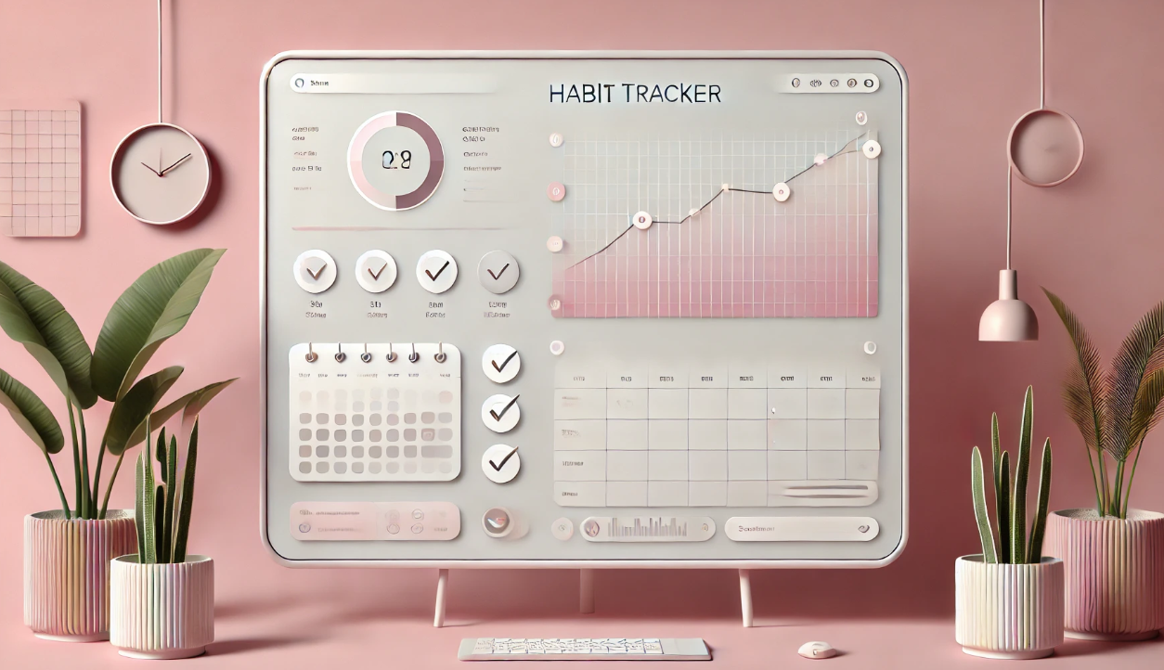
Raise Up
HABIT TRACKERS

Slide 2
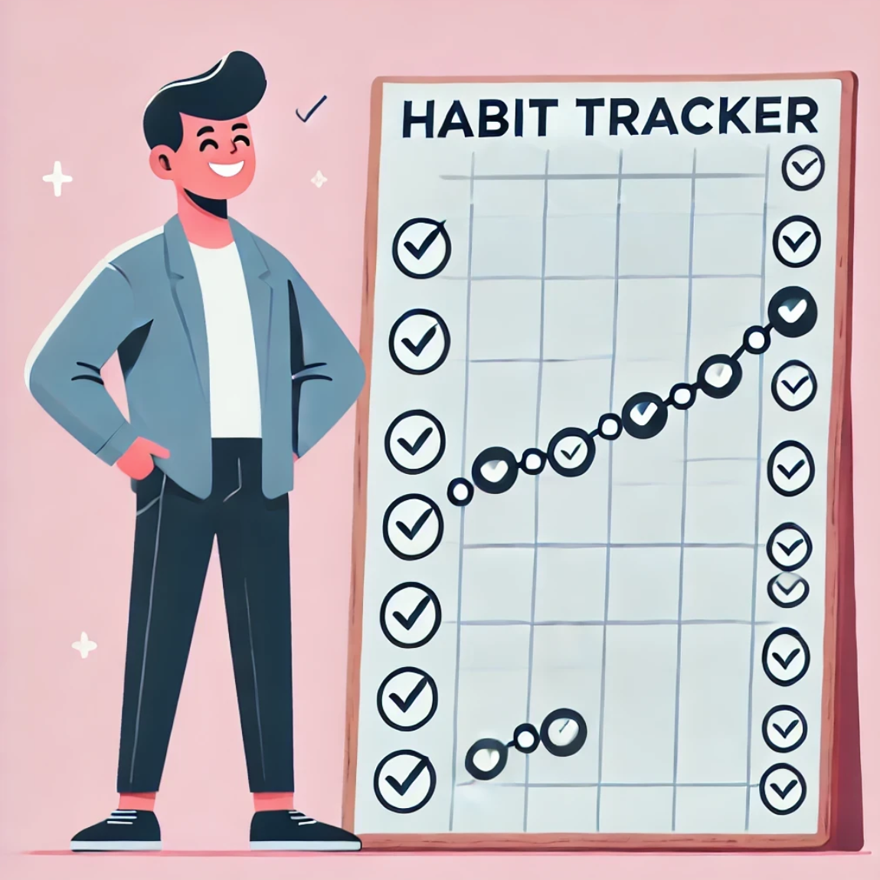

RAISE UP
THE HABIT TRACKER
This presentation outlines the development of a comprehensive habit-tracking system, designed to enhance consistency and streamline the process of building long-term habits. The project will aim to provide a user-friendly platform for users to track progress and stay motivated.

Slide 3

Understanding the Problem: Defining the Business Case
Current Challenges
Business Case
Many people struggle with building consistent habits due to lack of motivation, unclear progress tracking, and difficulty in maintaining streaks. Without a structured system, habits often break before becoming routine.
The Raise Up: Habit Mastery tracker provides a structured approach to habit-building with progress milestones, streak tracking, and unlockable rewards.

Slide 4


Crafting the Problem Statement: Key Elements and Considerations
1
Lack of Consistency in following
2
No Real – Time Progress Tracking
Building habits requires regular effort, but many people struggle with maintaining consistency, leading to slow progress or frequent restarts.
Without a proper system to track progress, it’s difficult to stay motivated and understand how close you are to achieving your goals.
3
Lack of Motivation & Accountability
Without clear milestones and rewards, it’s easy to lose motivation. A lack of accountability also makes it harder to stay on track.

Slide 5


Stakeholder Analysis: Identifying Key Stakeholders and Their Needs
Users
App Developers
Productivity Experts
A simple, intuitive tracker that helps them build and maintain habits with progress visualization, streaks.
A scalable, bug-free system with smooth UI/UX to ensure user engagement and retention.
Features based on behavioral science, like habit reinforcement techniques and goal-setting strategies.

Slide 6
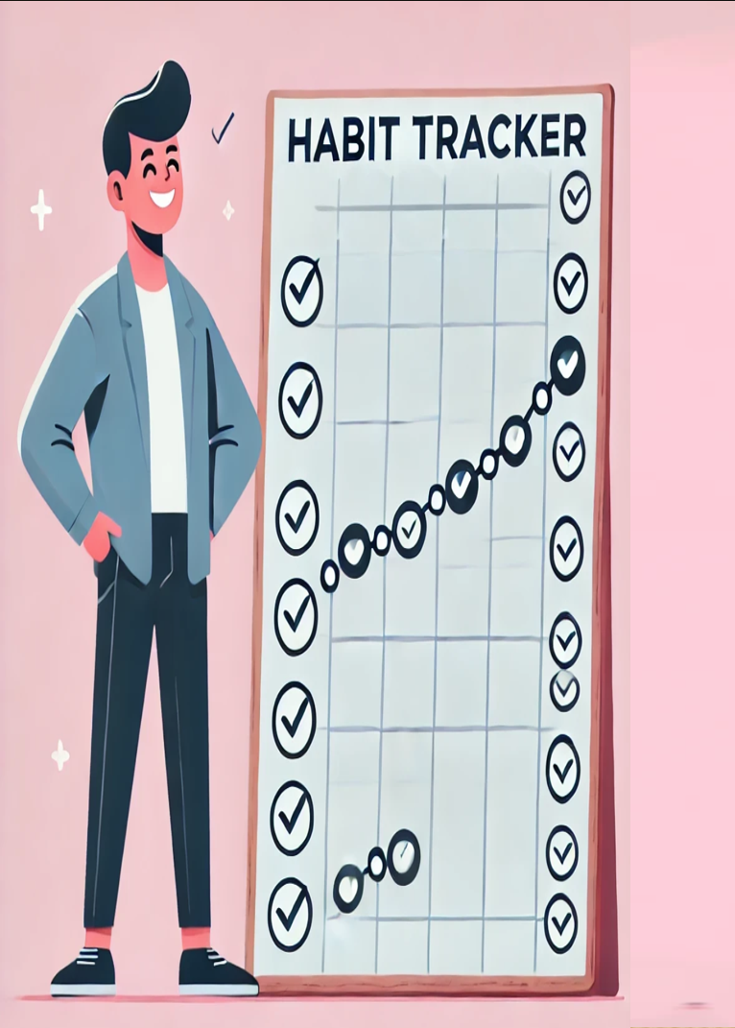




Proposed Solution: Aligning with Business Objectives
Real-Time Tracking
Two-Way Communication
Monitor vehicle locations, service provider routes, and ETA for improved efficiency.
Enable direct communication between drivers, service providers, and customer support.
Data Analytics
Generate reports and insights to optimize operations, improve service quality, and identify trends.

Slide 7


USER STORIES
User Story 1:
As a Backend Developer:
I want to implement a robust system to track user milestones and progress.
So That:
The application can accurately store and update habit completion data for each user.
Acceptance Criteria:
The backend should be able to track milestones and stars associated with each user's habits.
The system should update users' progress in real-time and be scalable for multiple users.
User data should be stored securely with progress data.

Slide 8
USER STORIES
User Story 2:
As a Frontend Developer:
I want to create an intuitive user interface to display progress visually.
So That:
Users can easily understand their progress and stay motivated to continue their habits.
Acceptance Criteria:
The interface should display stars, milestones, and locked content.
The app should have responsive design elements that adapt to various screen sizes.
Progress should be shown with a simple, colorful visual system for each tracked habit.

Slide 9
USER STORIES
User Story 3:
As a Student:
I want to unlock new study challenges after completing basic tasks..
So That:
I can stay motivated to improve my study habits and learn new techniques.
Acceptance Criteria:
The app should offer study-related habits that users can track.
After reaching milestones, new challenges or study techniques should unlock.
The system should gradually increase the complexity of study habits as I progress.

Slide 10

Product Vision Document
Audience
Primary Audience:
Individuals looking to build and maintain consistent habits
People who struggle with motivation and need structured progress tracking.
Users who prefer a gamified approach to habit-building with milestones and rewards.
Secondary Audience:
Productivity enthusiasts looking for an intuitive way to track habits.
Coaches and mentors who want to monitor and support others’ habit progress.
2. Needs
Primary Needs:
A structured habit tracker with milestone-based progression.
Visual indicators (⭐ Milestones, 🔥 Streaks, 🔒 Locked Activities) to encourage consistency.
Secondary Needs:
Insights and analytics on habit trends and progress.
Social or accountability features to keep users motivated.

Slide 11

Product Vision Document
3. Product
Core Product:
A mobile and web-based habit mastery tracker that helps users build consistent habits through gamification, milestone-based rewards, and streak tracking.
Additional Features:
Smart Habit Reminders: Automated notifications to reinforce consistency.
Gamified Milestones: Progress tracking through stars, streaks, and unlockable achievements.
4. Values
Core Values:
Consistency: Helping users develop long-term habits through structured tracking.
Engagement: Making habit tracking fun and rewarding.
Differentiators:
Milestone-Based Progression: Encouraging small wins to keep users motivated.
Gamification Elements: Streaks, rewards, and locked activities create a dynamic experience.

Slide 12

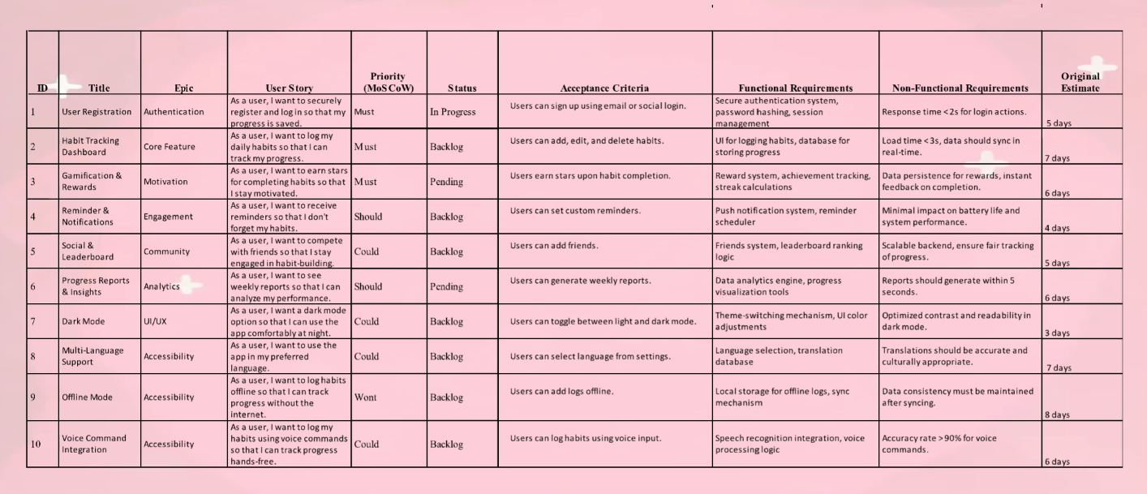
PRODUCT BACKLOG REFINEMENT

Slide 13
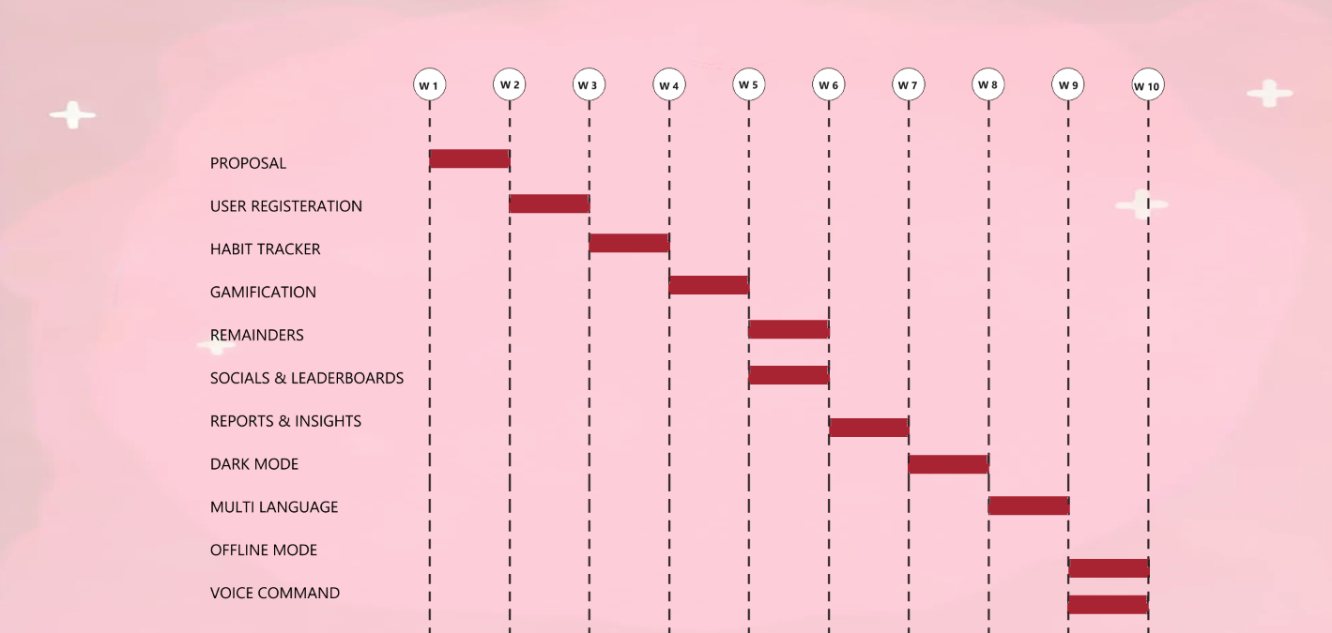
Release Plan – GANTT Chart

Slide 14

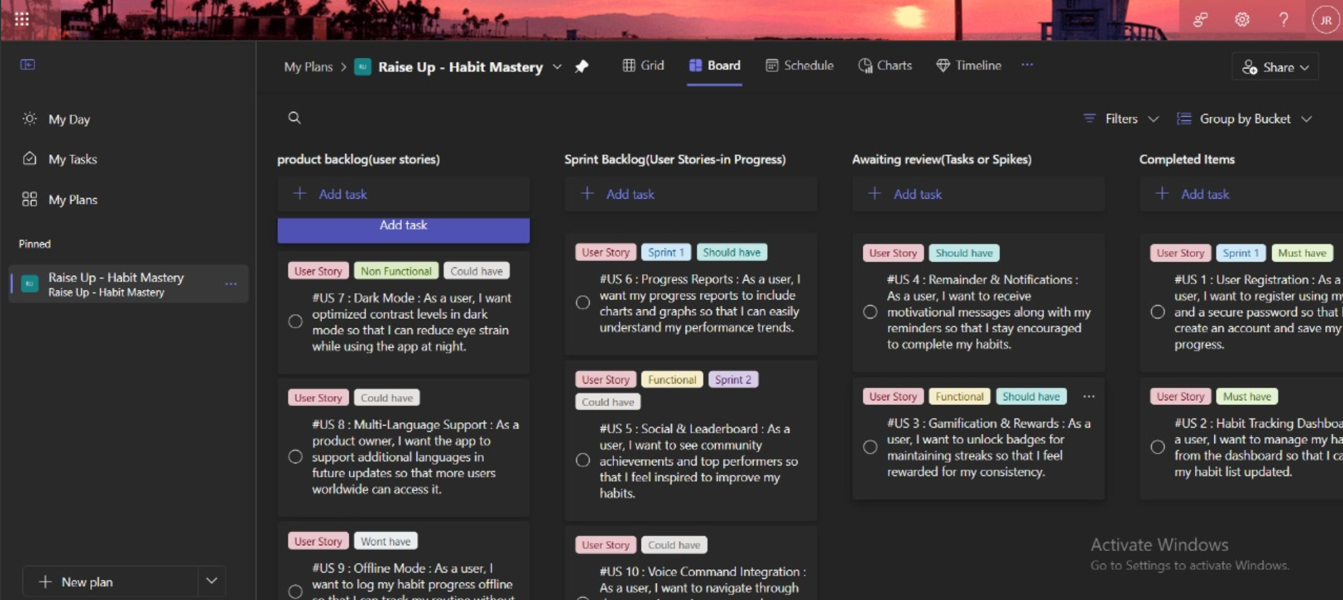
MICROSOFT PLANNER

Slide 15
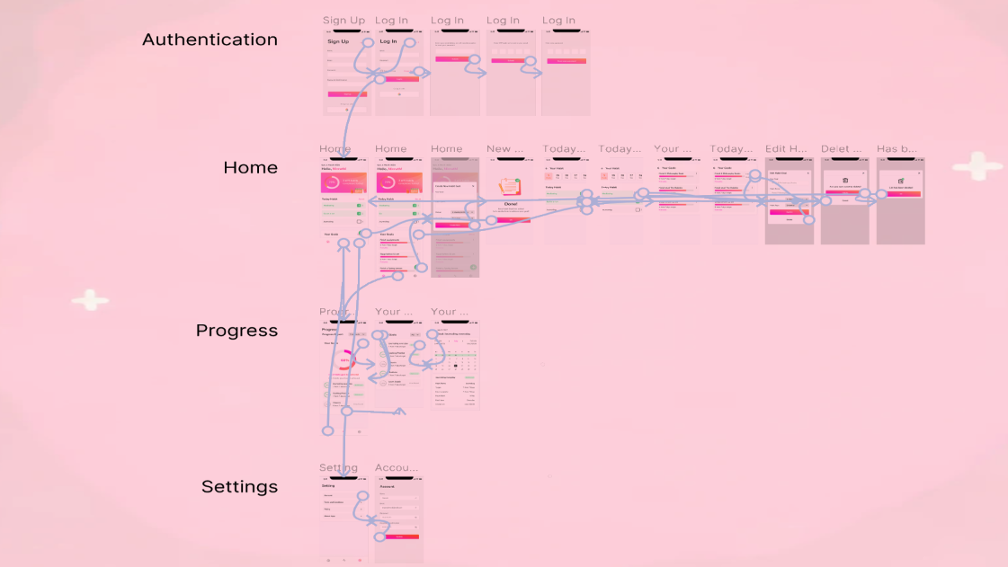
APPLICATION PROTOTYPE

Slide 16
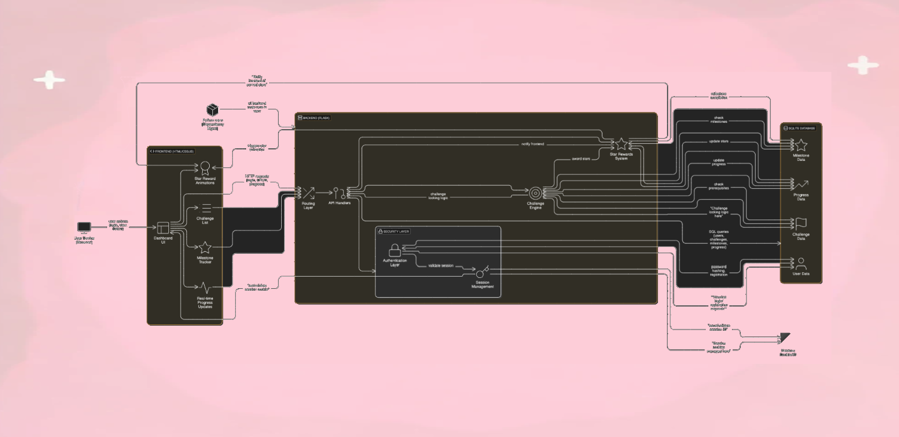
PROTOTYPE ARCHITECTURAL DIAGRAM

Slide 17
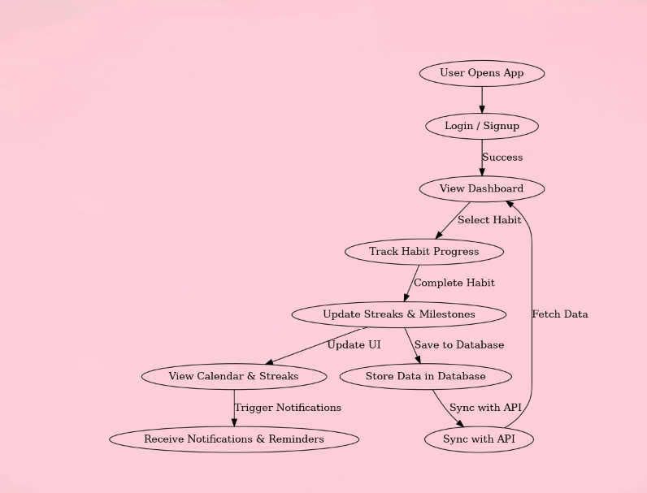
DATA FLOW DIAGRAM

Slide 18
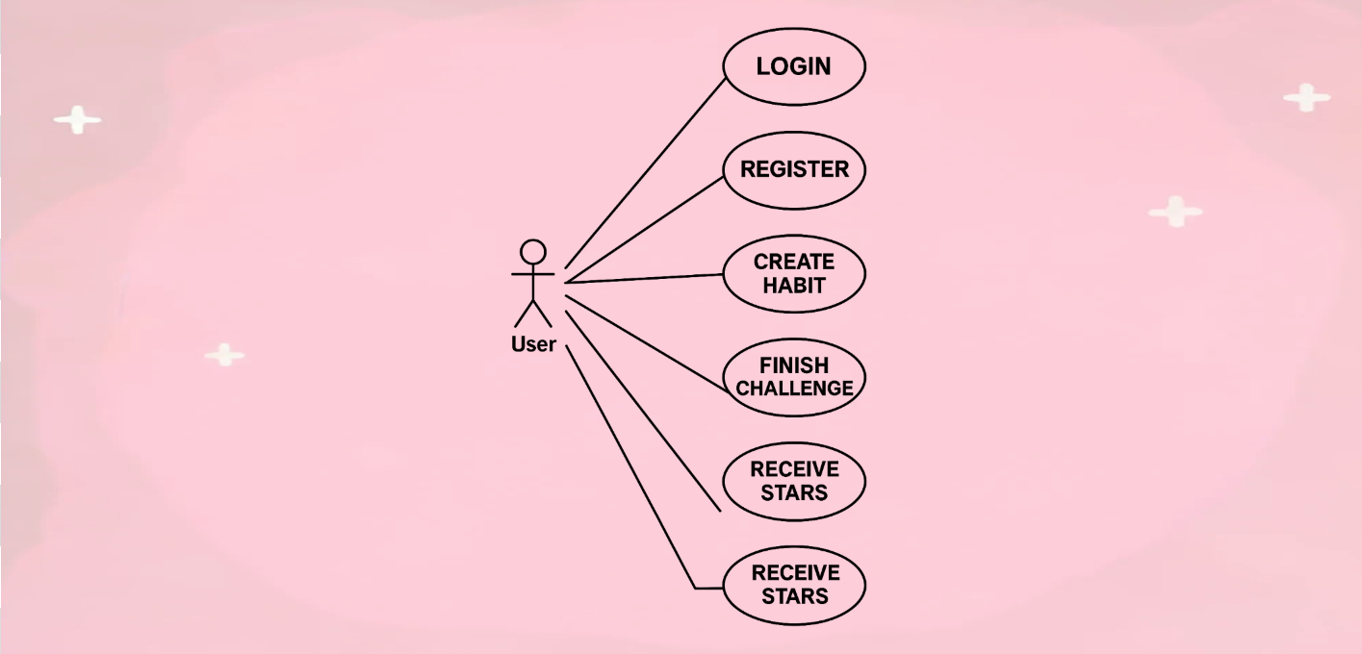
UML DIAGRAM

Slide 19


Next Steps: Initiating the Project and Securing Approval
The next step is to develop a detailed project plan, outlining the project scope, timeline, budget, and resources. This plan will then be presented to key stakeholders for review and approval.

Slide 20

THANK YOU

